Slide 1
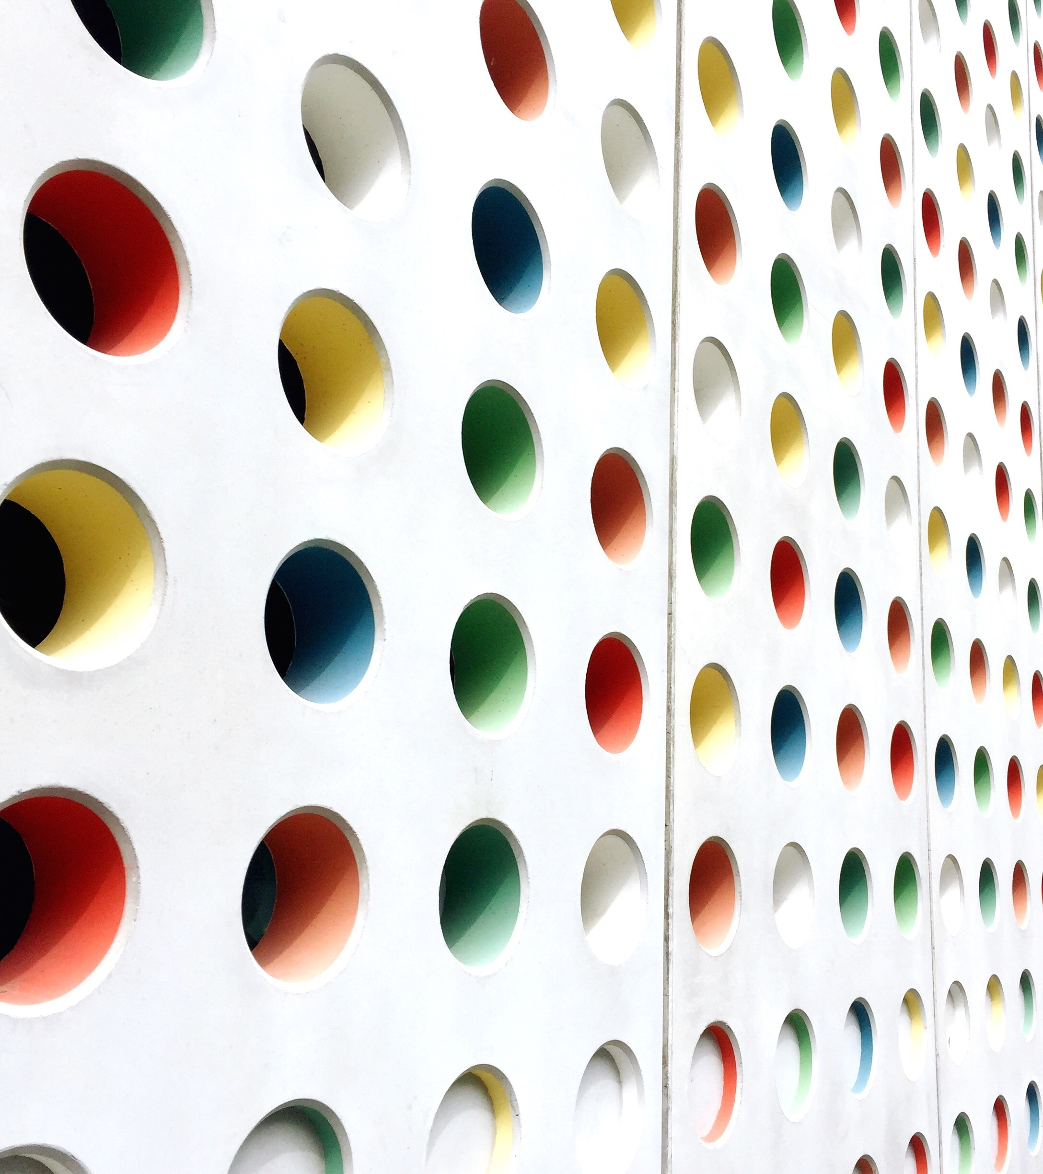
Computer Vision-OpenCV
(AIR CANVAS)

Slide 2
Open CV
OpenCV is the huge open-source library for the computer vision, machine learning, and image processing.
When it integrated with various libraries, such as NumPy, python is capable of processing the OpenCV array structure for analysis. To Identify image pattern and its various features we use vector space and perform mathematical operations on these features.
It is widely used in object detection, air canvas, facial recognition and hand gestures movement.

Slide 3
Project on Air Canvas
It is a project which detects the finger tip, creates masks of the same and then generate contours using deque. You can draw anything in the allotted free space and can choose colour from the window.
The traditional method of writing includes pen and paper. The essential aim of this air canvas is building hand gesture recognition system to write digitally. It uses computer vision to trace the path of the finger. The generated text can also be used for various purposes, such as sending messages, emails etc. It will be a powerful means of communication for the deaf.

Slide 4



Pre-requisite of project
Python
Open cv
NumPy

Slide 5
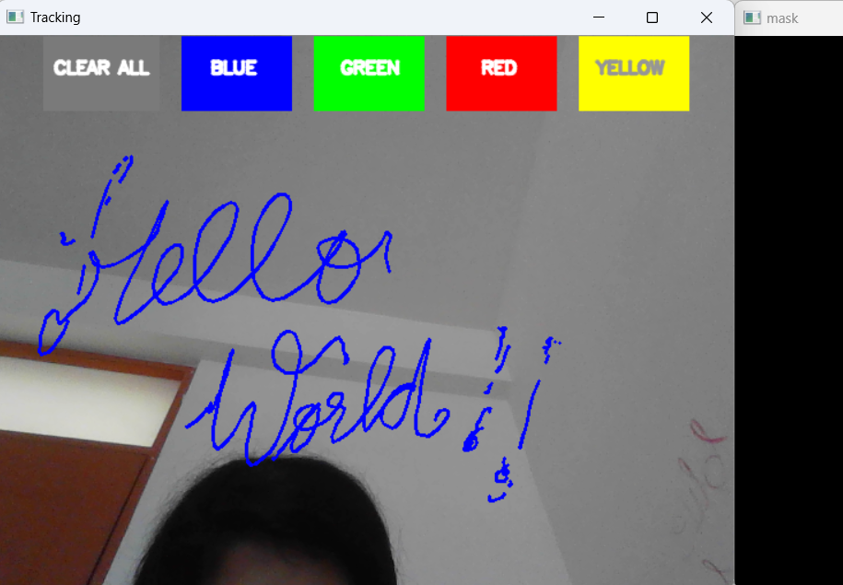
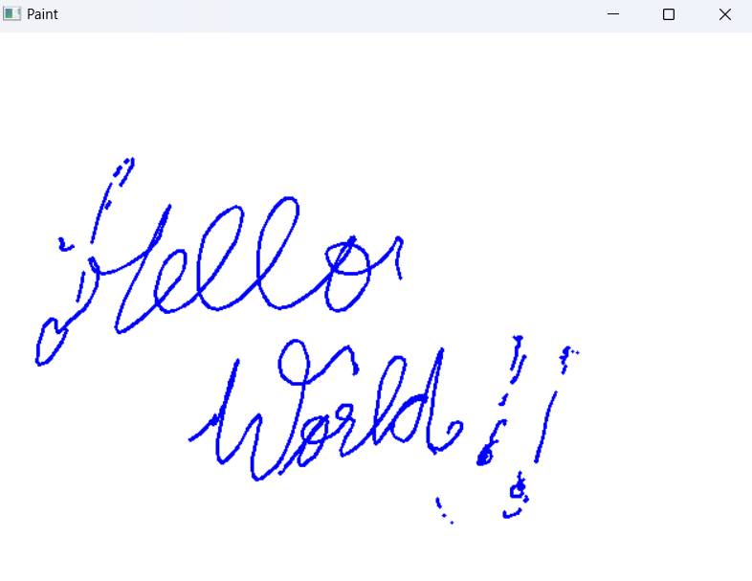
Computer vision program implemented
Using libraries OpenCV , deque , NumPy

Slide 6
Workflow of the project
In total four windows have been created to accomplish all the functionalities. One is HSV, other is paint window, other one is mask and last one is video Capture window.
Colour detection and tracking are used in order to achieve the objective. A mask is created around the bead and then the colour marker is predicted. It further includes more operation on mask such as erosion and dilation. Erosion reduces the impurities present in the mask and dilation further restores the eroded main mask.

Slide 7
Working:
1. Start reading the frames and convert the captured frames to HSV colour space.
2. Prepare the canvas frame and put the respective ink buttons on it.
3. Adjust the trackbar values for finding the mask of coloured marker.
4. Preprocess the mask with erosion and dilation operation.
5. Detect the contours, find the center coordinates of largest contour and keep storing them in the array for successive frames.
6. Finally draw the points stored in array on the frames and canvas.

Slide 8
Thank You
Submitted by:
Shreya Agrawal 102217170
Arshdeep kaur 102217192

